Slide 1
Lecture 8: Multivariate models
May 15, 2018
Learning objectives:
Implement and evaluate spatial factor analysis
Understand interpretation of additive covariance matrices

Slide 2
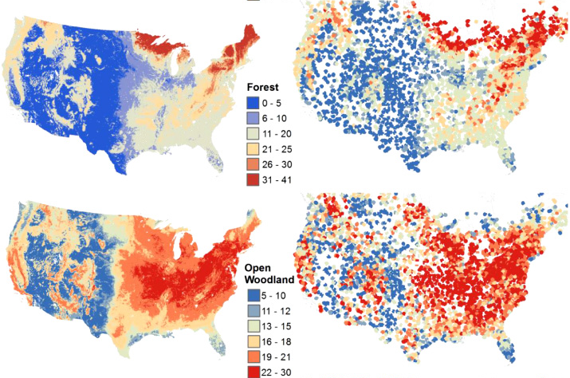
Species richness of North American birds from Breeding Bird Survey
Image: Goetz et al. 2014 Environ. Res. Lett.

Slide 3
Community distribution models
Why an interest in distributions?
Suggestive of environmental and biological drivers
Motivate subsequent models and research
Distribution maps are intuitive for many users
Framework for local and traditional knowledge
Distribution models are a playground
Explore climate, invasions, habitat restoration, …
Notes:
Explain why I want to do this! (motivates theory of environmental or biological drivers for distributions)

Slide 4
Community distribution models
Spatial ordination is useful for …
Quantifying shared information among species
Identifying species with similar range
Correlating species range with measured variables
Notes:
Predicting rare/undersampled species, bycatch etc.

Slide 5
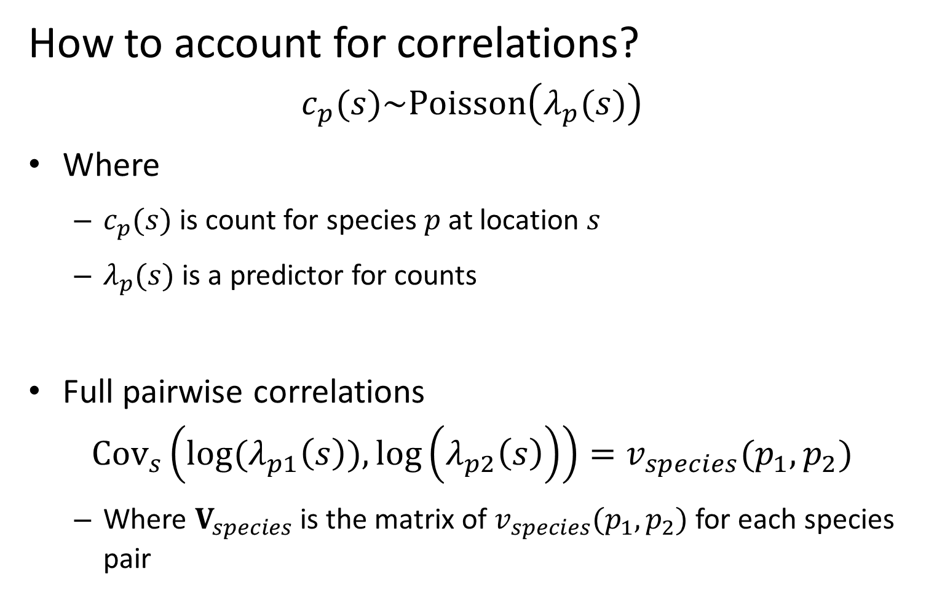
Community distribution models
How to account for correlations?
$$c_{p}(s)\sim Poisson\left(λ_{p}(s)\right)$$
Where
$c_{p}(s)$ is count for species $p$ at location $s$
$λ_{p}(s)$ is a predictor for counts
Full pairwise correlations
$${Cov}_{s}\left(log⁡(λ_{p1}\left(s\right)),\log\left(λ_{p2}\left(s\right)\right)\right)=v_{species}(p_{1},p_{2})$$
Where $V_{species}$ is the matrix of $v_{species}(p_{1},p_{2})$ for each species pair
Notes:
Predicting rare/undersampled species, bycatch etc.

Slide 6
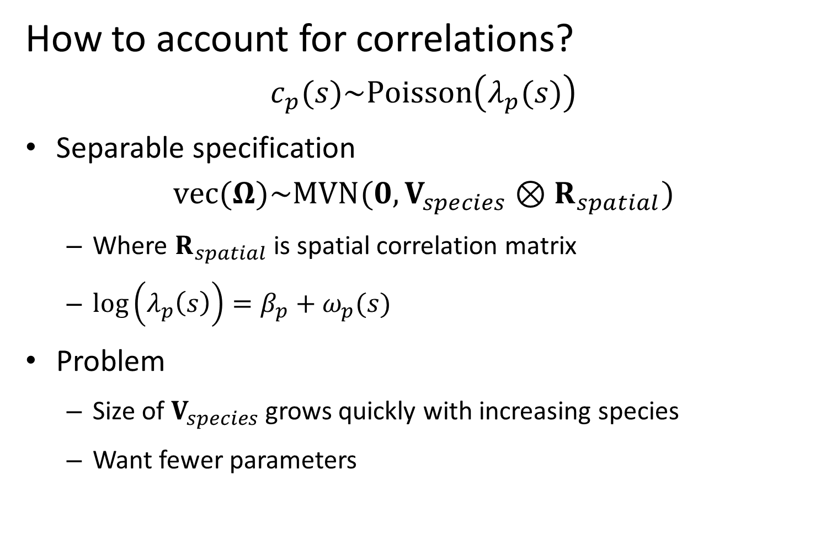
Community distribution models
How to account for correlations?
$$c_{p}(s)\sim Poisson\left(λ_{p}(s)\right)$$
Separable specification
$$vec(Ω)\sim MVN(0,V_{species}⊗R_{spatial})$$
Where $R_{spatial}$ is spatial correlation matrix
$\log\left(λ_{p}\left(s\right)\right)=β_{p}+ω_{p}(s)$
Problem
Size of $V_{species}$ grows quickly with increasing species
Want fewer parameters
Notes:
Predicting rare/undersampled species, bycatch etc.

Slide 7
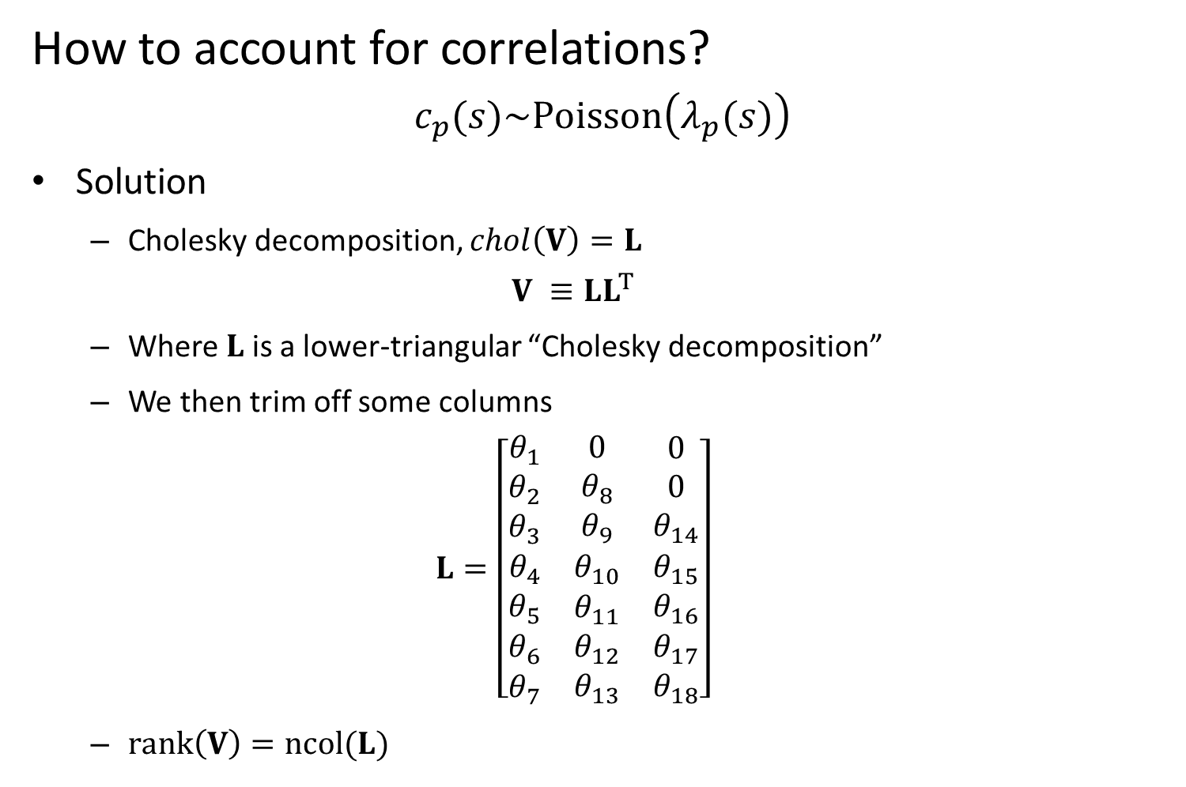
Community distribution models
How to account for correlations?
$$c_{p}(s)\sim Poisson\left(λ_{p}(s)\right)$$
Solution
Cholesky decomposition, $chol\left(V\right)=L$
$$V ≡LL^{T}$$
Where $L$ is a lower-triangular “Cholesky decomposition”
We then trim off some columns
$$L=\left[\begin{matrix}\begin{matrix}θ_{1} \\ θ_{2} \\ θ_{3}\end{matrix} & \begin{matrix}0 \\ θ_{8} \\ θ_{9}\end{matrix} & \begin{matrix}0 \\ 0 \\ θ_{14}\end{matrix} \\ θ_{4} & θ_{10} & θ_{15} \\ \begin{matrix}θ_{5} \\ θ_{6} \\ θ_{7}\end{matrix} & \begin{matrix}θ_{11} \\ θ_{12} \\ θ_{13}\end{matrix} & \begin{matrix}θ_{16} \\ θ_{17} \\ θ_{18}\end{matrix}\end{matrix}\right]$$
$rank\left(V\right)=ncol(L)$
Notes:
Predicting rare/undersampled species, bycatch etc.

Slide 8
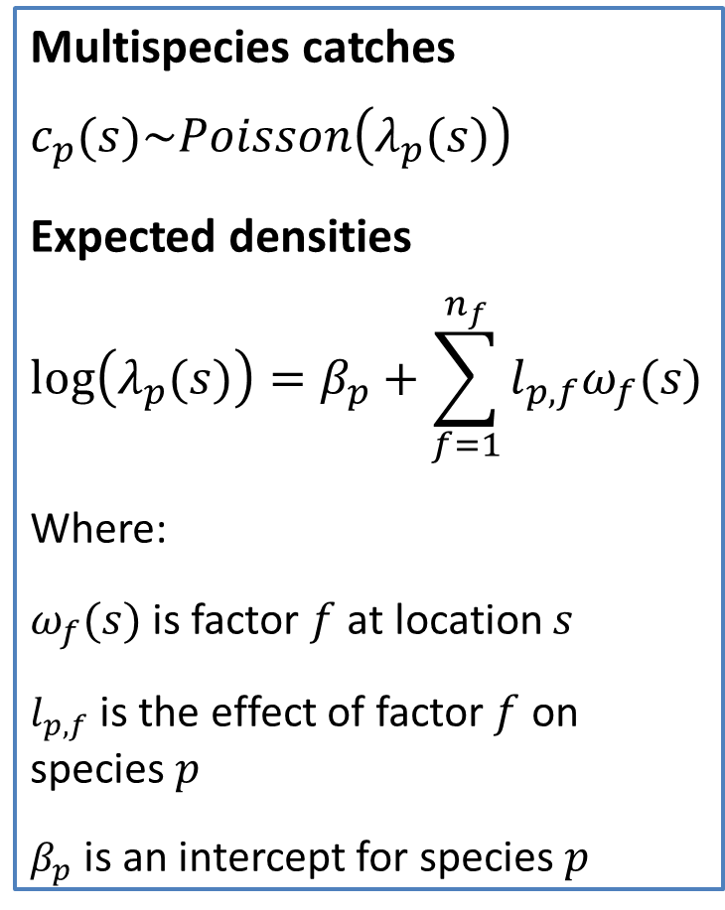
Community distribution models
Spatial factor analysis
Estimates “latent” maps for co-occurring species
Separates process and measurement error
Derived estimates of co-occurrence
Multispecies catches
$$c_{p}(s)\sim Poisson\left(λ_{p}(s)\right)$$
Expected densities
$$log⁡\left(λ_{p}(s)\right)=β_{p}+\sum_{f=1}^{n_{f}}{l_{p,f}ω_{f}(s)}$$
Where:
$ω_{f}(s)$ is factor $f$ at location $s$
$l_{p,f}$ is the effect of factor $f$ on species $p$
$β_{p}$ is an intercept for species $p$
Notes:
Animate in the math

Slide 9
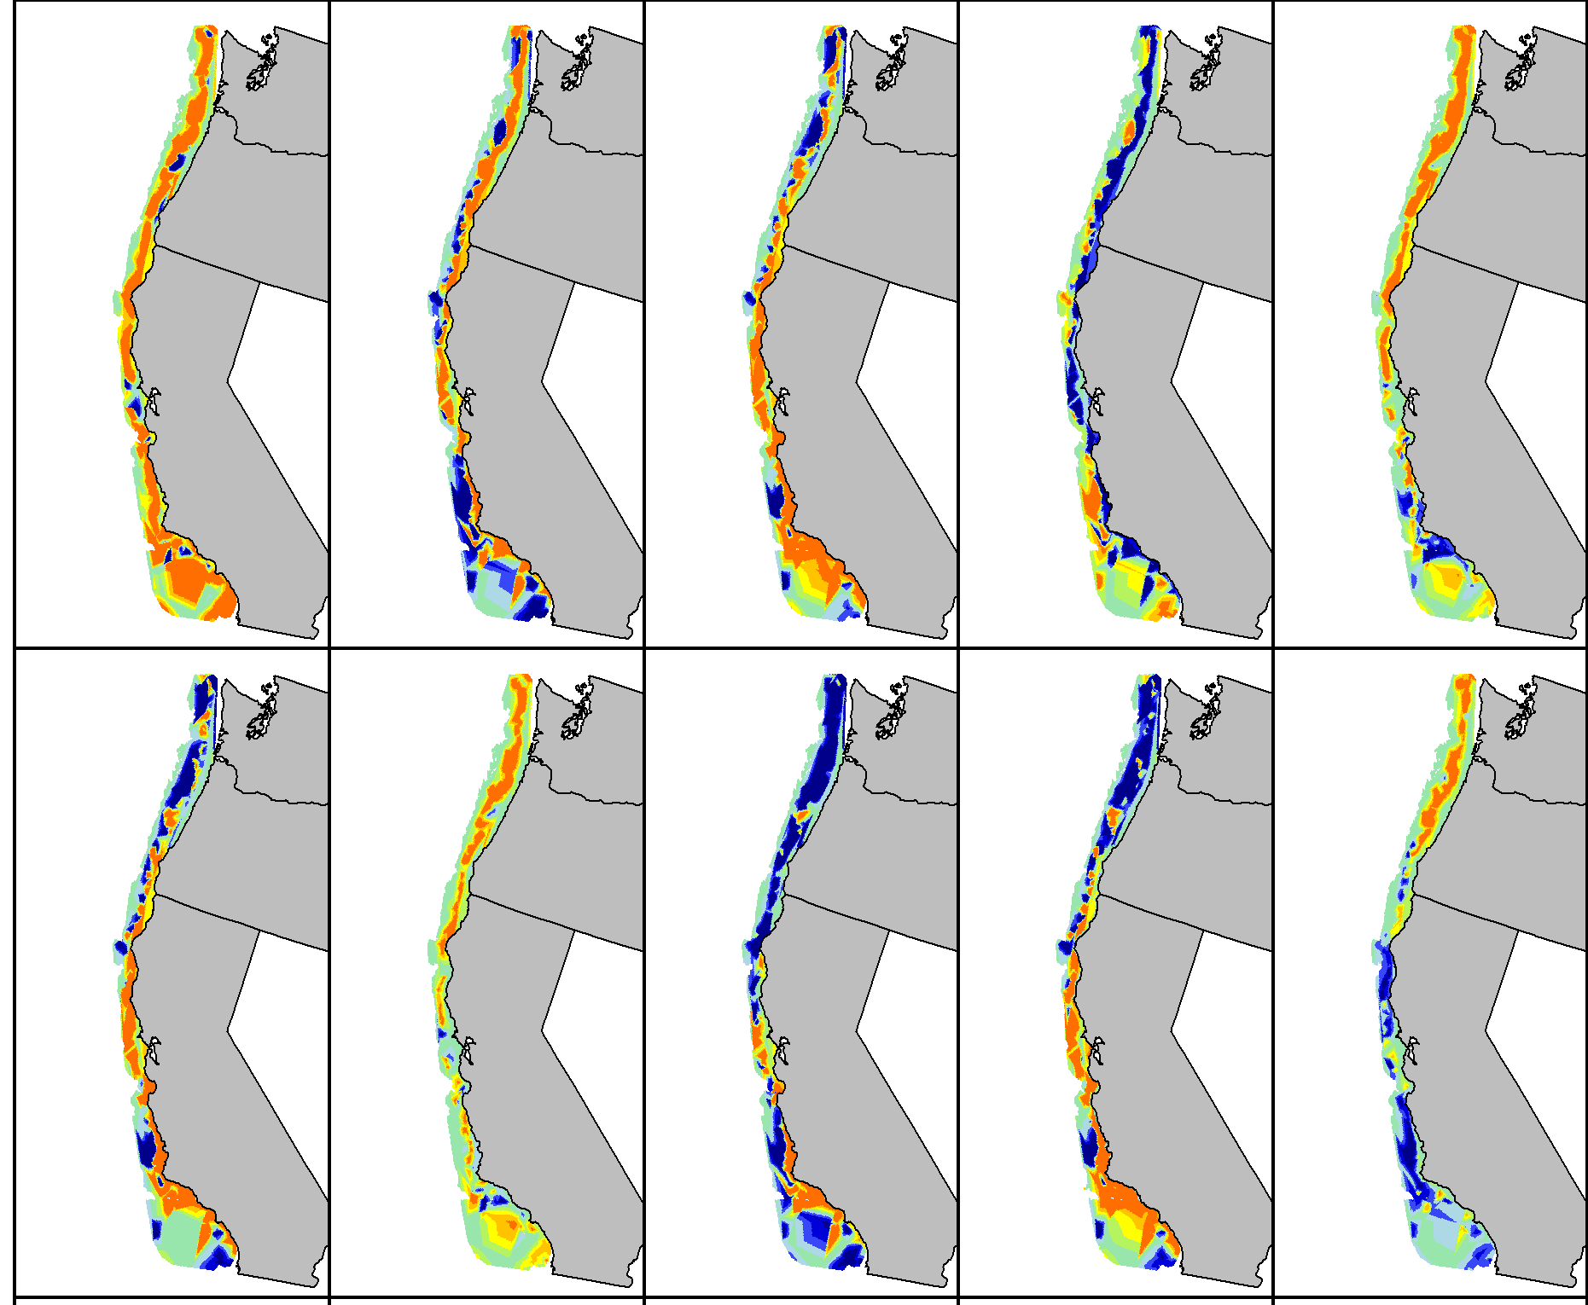
Predicted species distributions: High density / Medium density / Low density
Notes:
Explain colors (red: high);
Fix no-name panel!
Circle darkblotched and aurora (actually bring them forward in new slide)

Slide 10
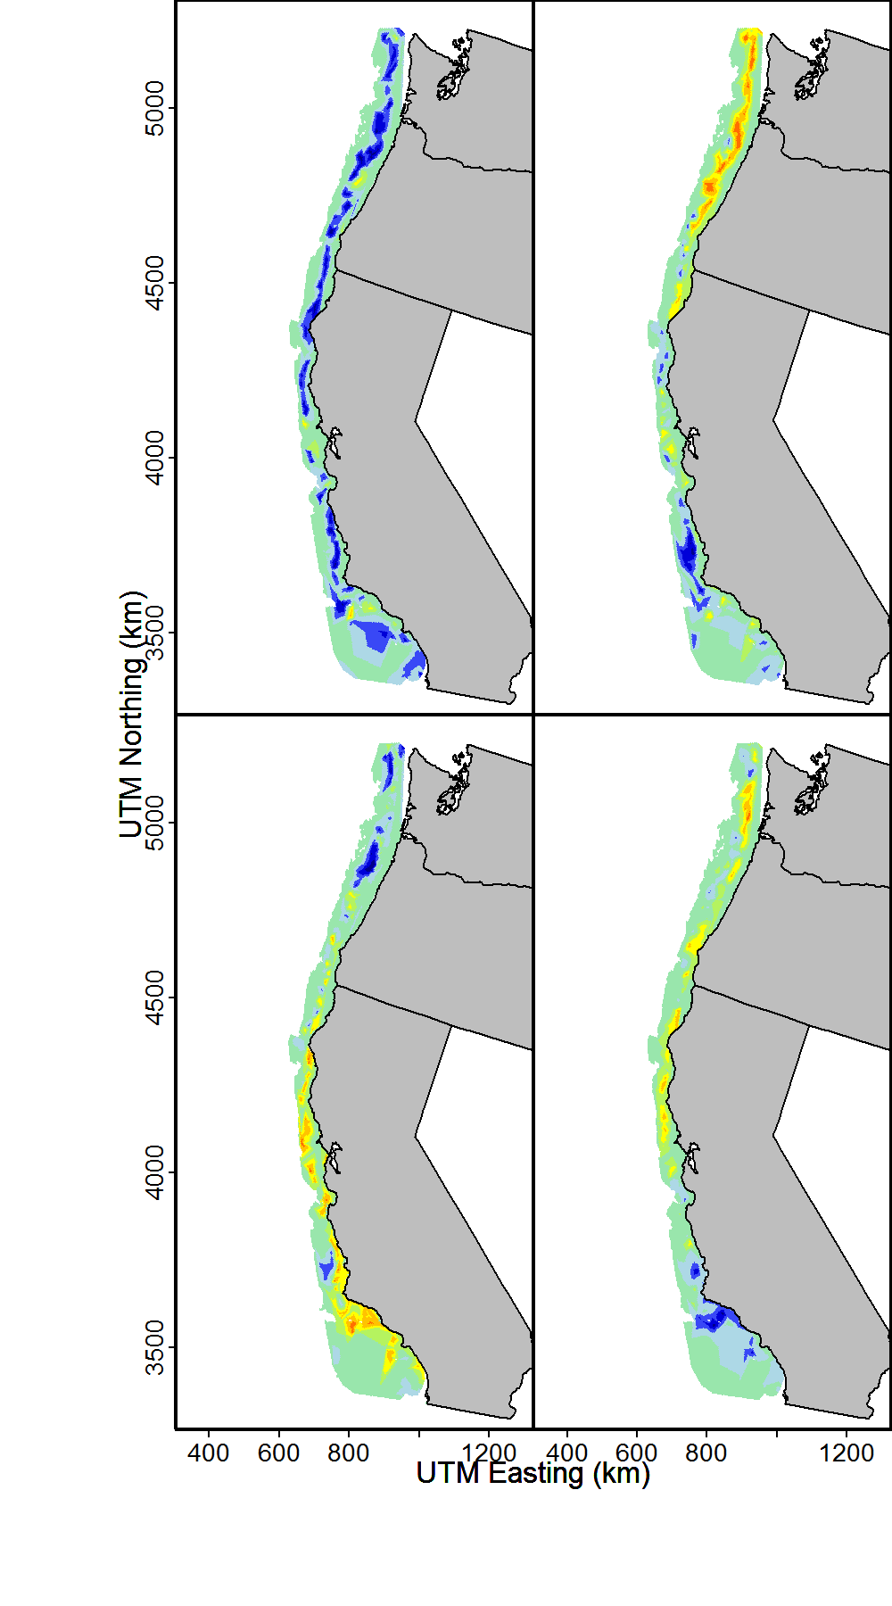
Community distribution models
Estimating latent factors
Estimated spatial factors: High density / Medium density / Low density
Notes:
Lots of shared information;
Talk about measured covariates; biogeographic breaks; searching for better descriptors

Slide 11
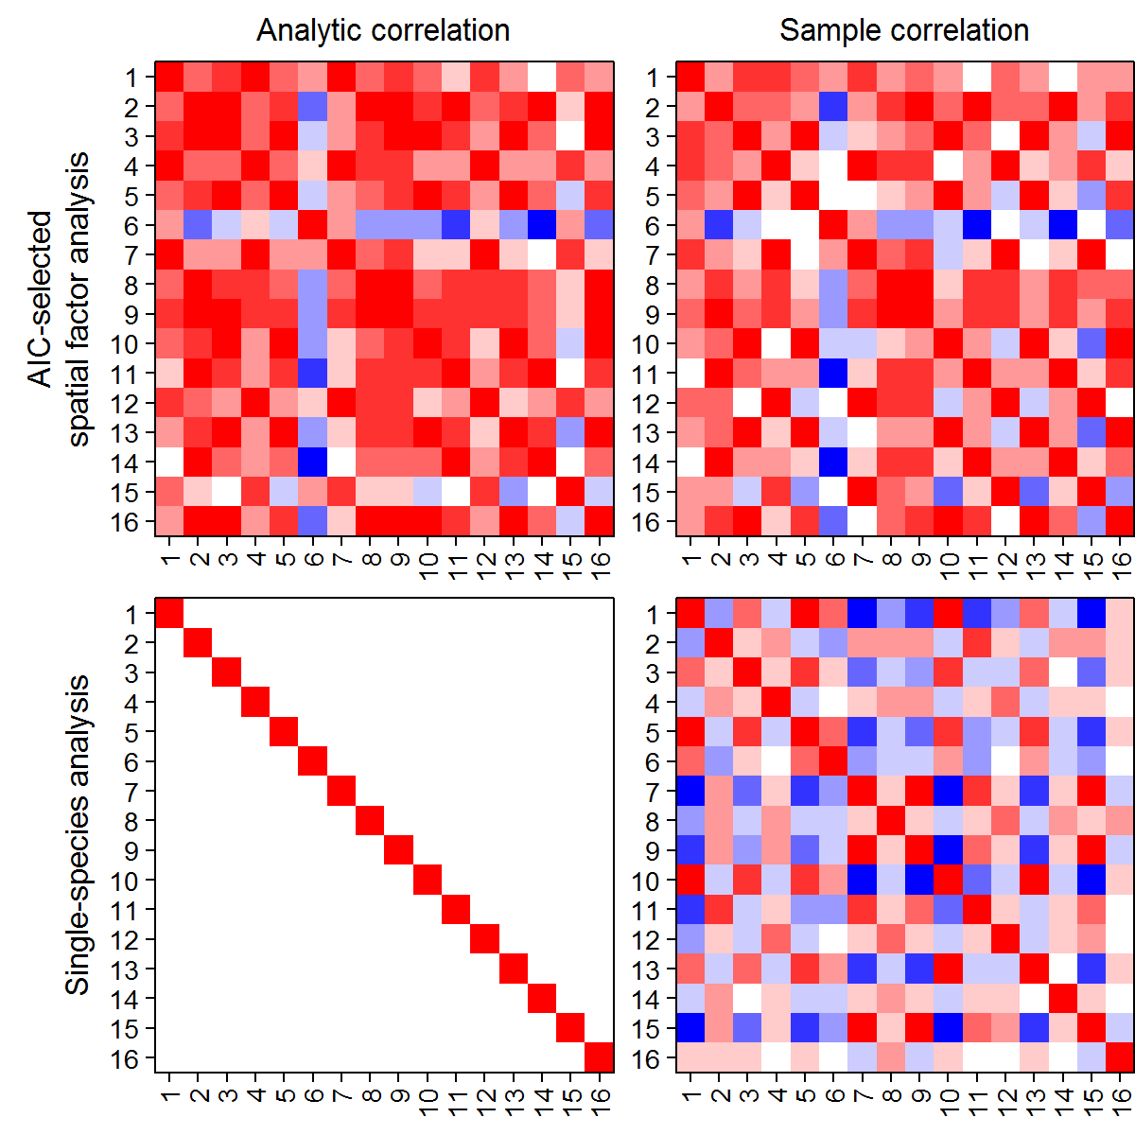
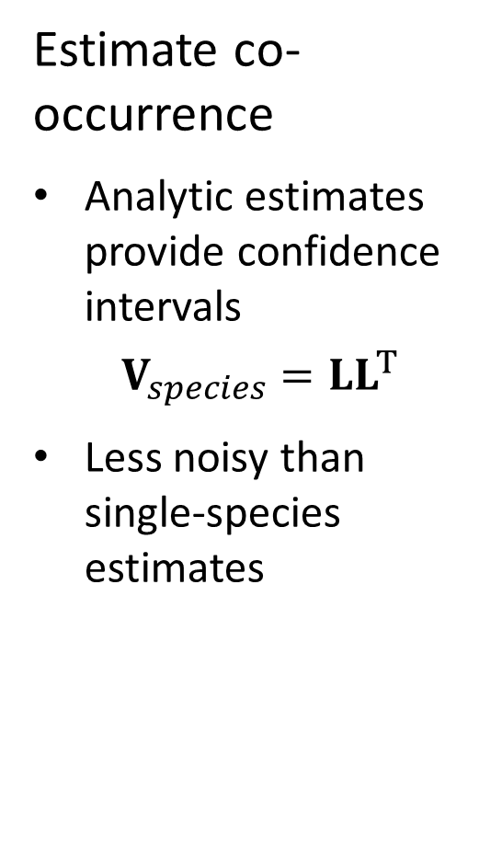
Community distribution models
Estimate co-occurrence
Analytic estimates provide confidence intervals
$$V_{species}=LL^{T}$$
Less noisy than single-species estimates
Correlation: 1 0 -1
Notes:
Animate these in; (explain colors immediately – ADD COLORS TO TEXT)
Consider dropping analytic column

Slide 12
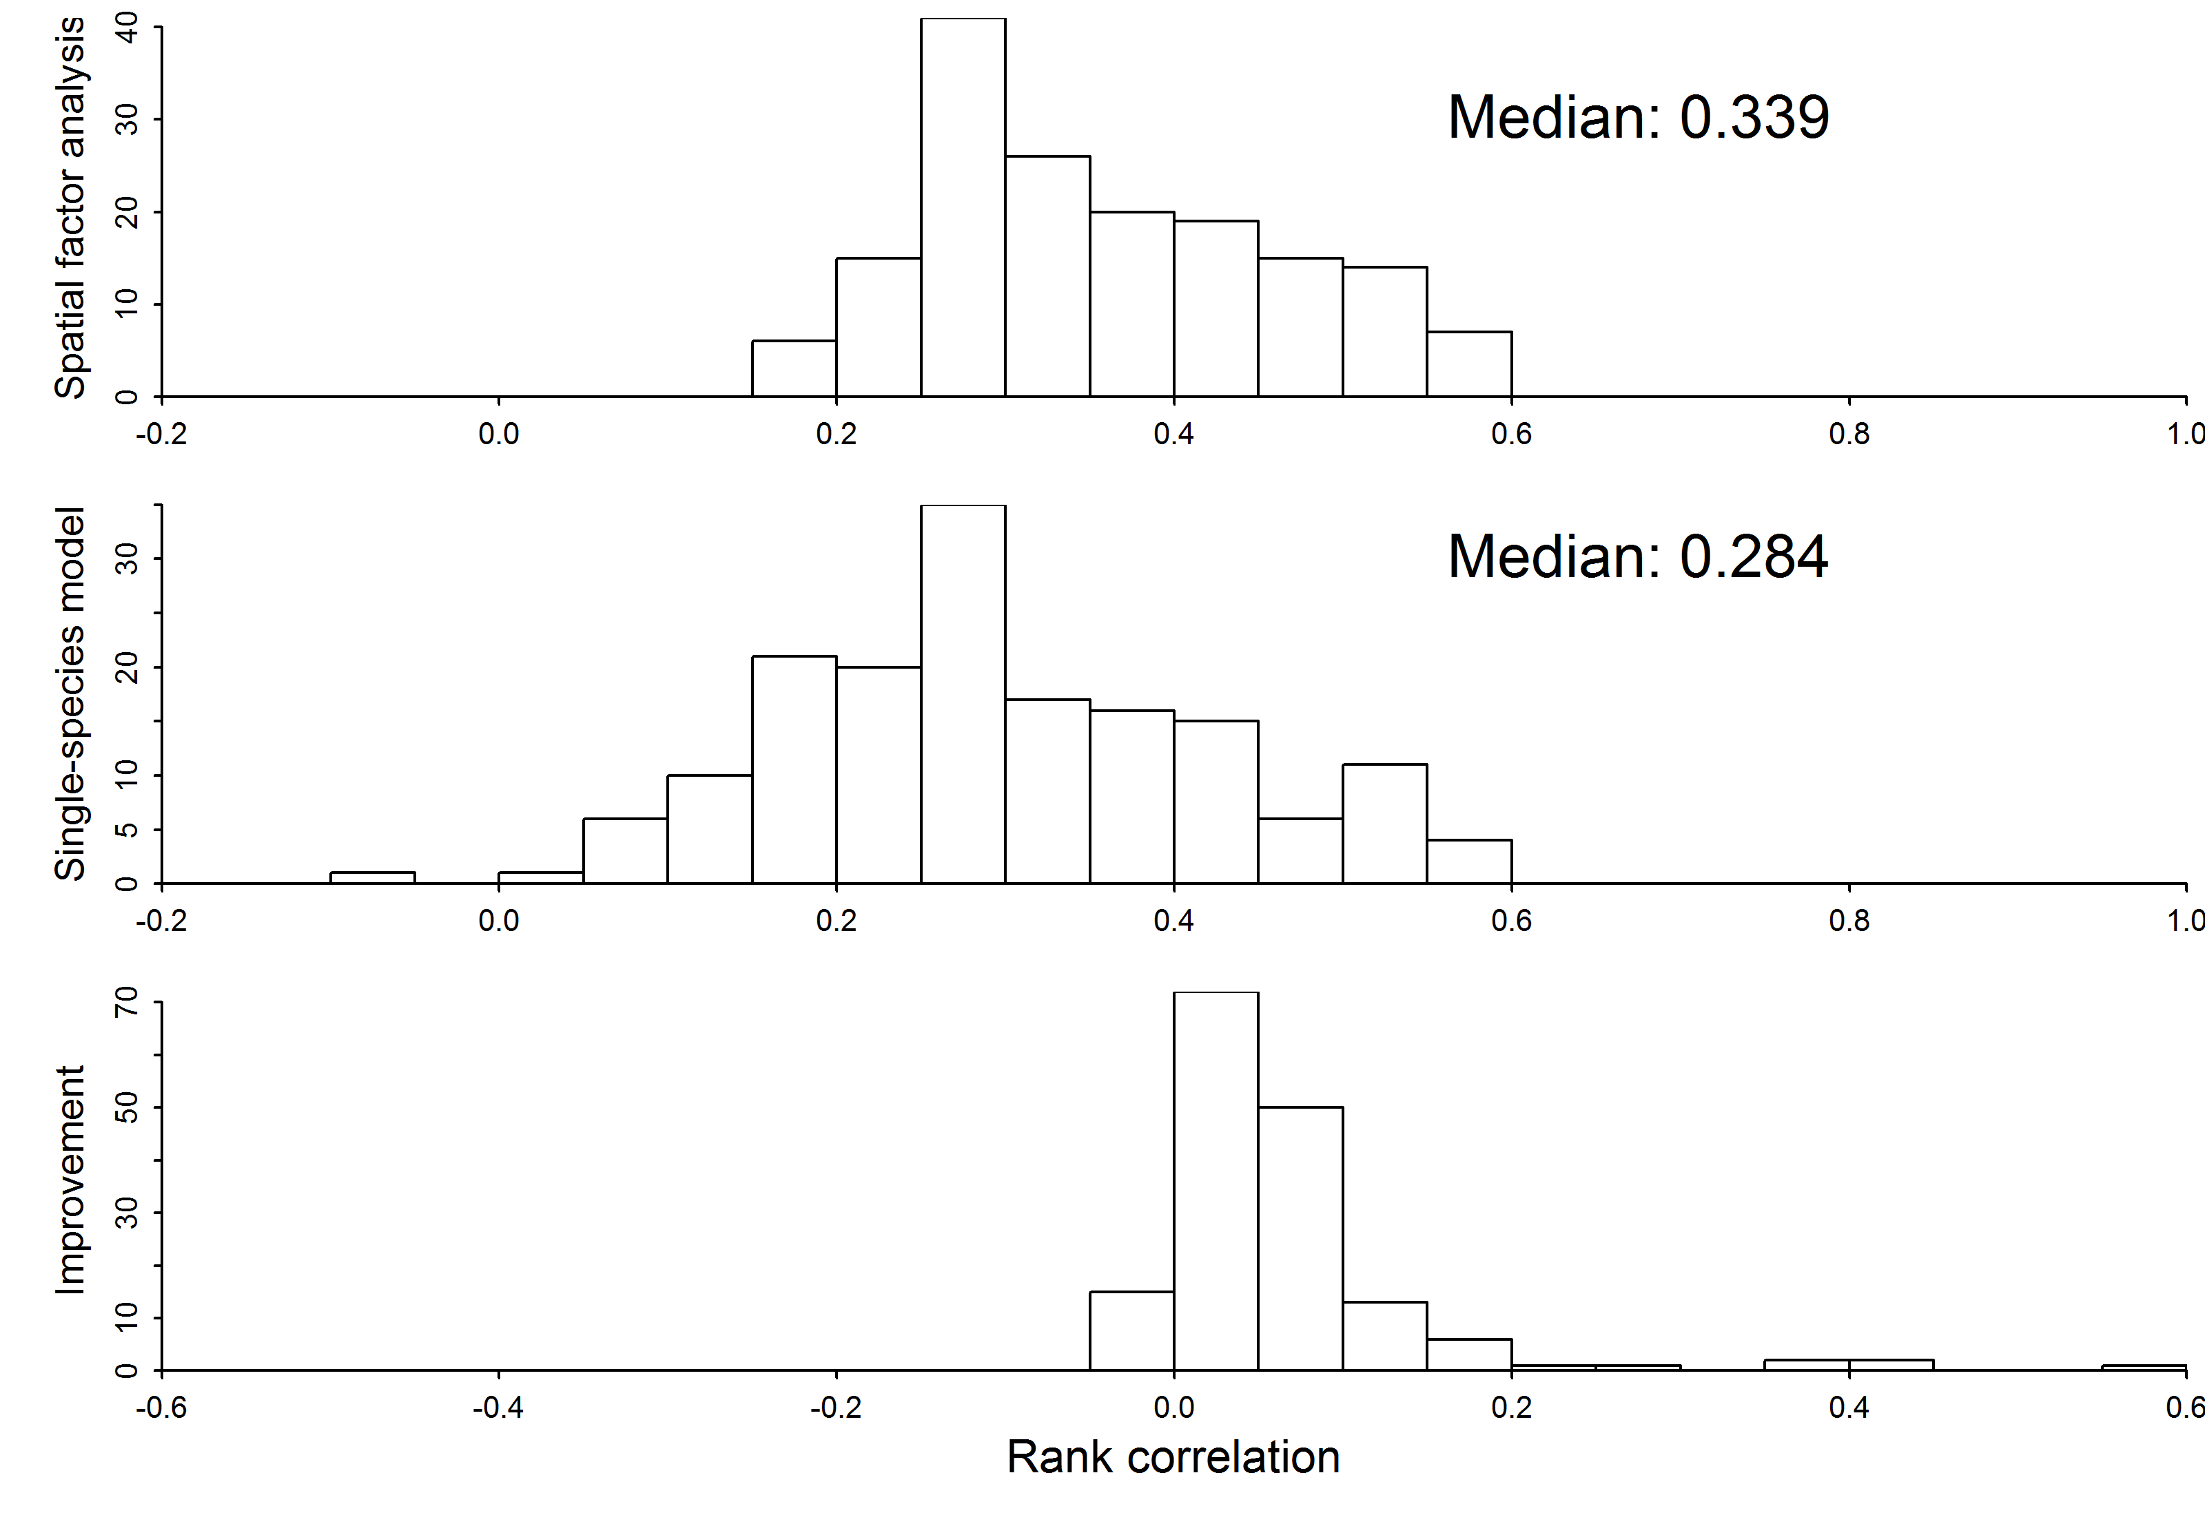
Community distribution models
Improves prediction
Spatial factor analysis
Single species models
Difference between methods
Bad Predictive accuracy Good
Notes:
Label y-axis
Bottom one; show line dividing single species and multispecies

Slide 13
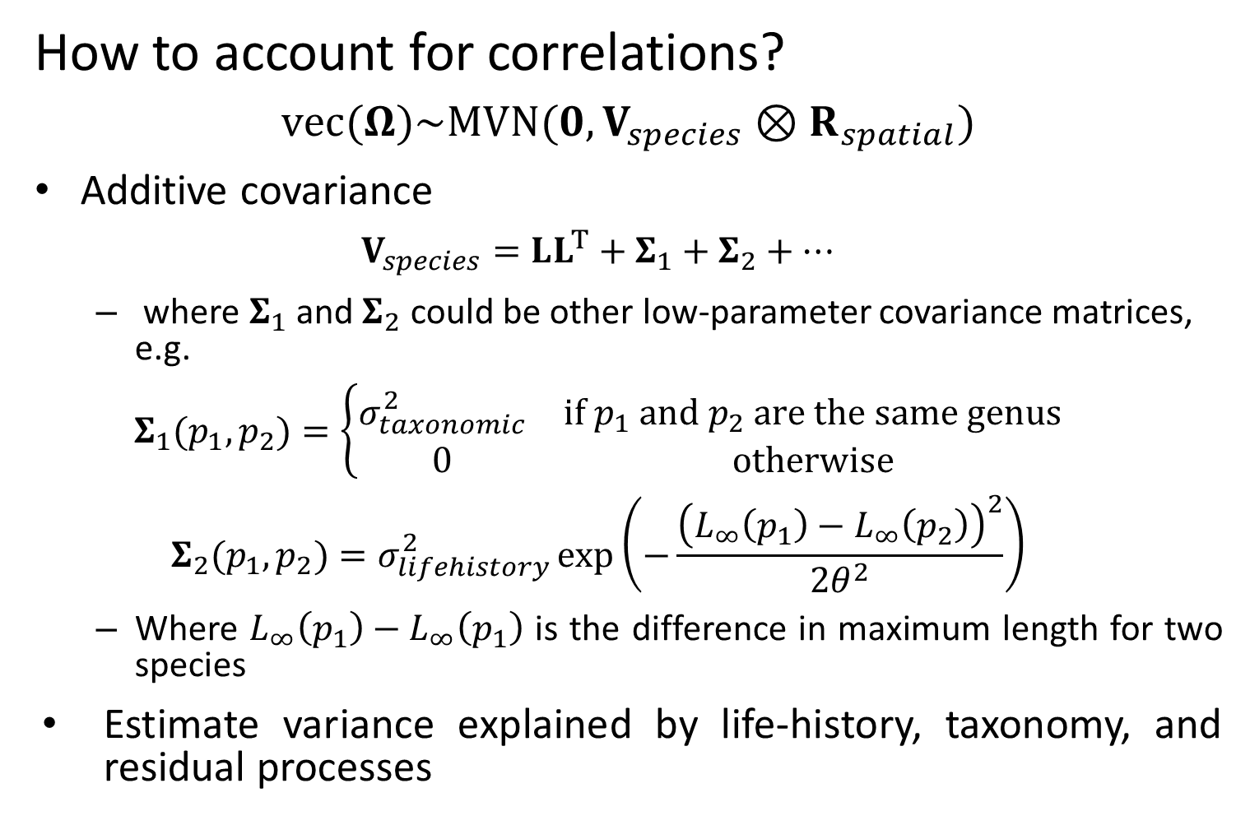
Community distribution models
How to account for correlations?
$$vec(Ω)\sim MVN(0,V_{species}⊗R_{spatial})$$
Additive covariance
$$V_{species}=LL^{T}+Σ_{1}+Σ_{2}+…$$
where $Σ_{1}$ and $Σ_{2}$ could be other low-parameter covariance matrices, e.g.
$$Σ_{1}(p_{1},p_{2})=\left\{\begin{matrix}σ_{taxonomic}^{2} & if p_{1} and p_{2} are the same genus \\ 0 & otherwise\end{matrix}\right.$$
$$Σ_{2}(p_{1},p_{2})=σ_{lifehistory}^{2}\exp\left(−\frac{{\left(L_{∞}\left(p_{1}\right)−L_{∞}\left(p_{2}\right)\right)}^{2}}{2θ^{2}}\right)$$
Where $L_{∞}\left(p_{1}\right)−L_{∞}\left(p_{1}\right)$ is the difference in maximum length for two species
Estimate variance explained by life-history, taxonomy, and residual processes
Notes:
Predicting rare/undersampled species, bycatch etc.

Slide 14

Community distribution models
Expected densities
$$log⁡\left(λ_{p}(s)\right)=β_{p}+\sum_{f=1}^{n_{f}}{l_{p,f}ω_{f}(s)}$$
Is equivalent to:
$$log⁡\left(λ_{p}(s)\right)=β_{p}+\sum_{f=1}^{n_{f}}{l_{p,f}^{∗}ω_{f}^{∗}(s)}$$
Where
$$L^{∗}=LH$$
$$Ω^{∗}=H^{−1}Ω$$
and where $H$ is a rotation matrix
Notes:
Animate in the math

Slide 15
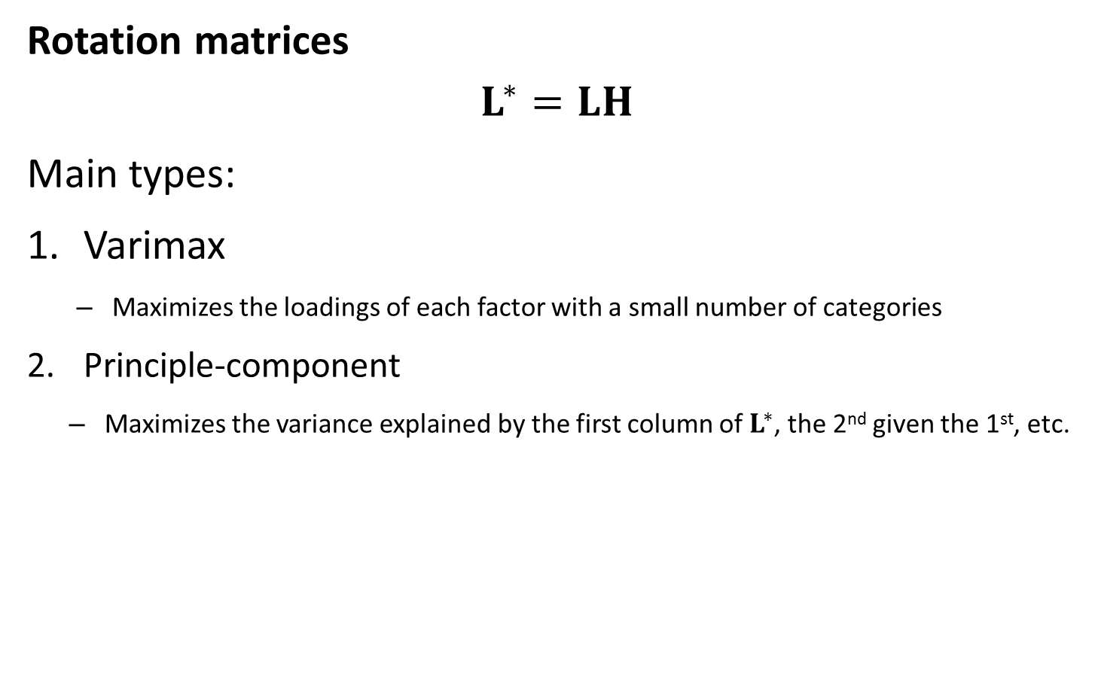
Community distribution models
Rotation matrices
$$L^{∗}=LH$$
Main types:
Varimax
Maximizes the loadings of each factor with a small number of categories
Principle-component
Maximizes the variance explained by the first column of $L^{∗}$, the 2nd given the 1st, etc.
Notes:
Animate in the math

Slide 16
Community distribution models
Interpretation of covariance matrix
Associations
Major axis regression
Linear regression
Notes:
Animate in the math

Slide 17
Community distribution models
Factor analysis
Warton, D.I., Blanchet, F.G., O’Hara, R.B., Ovaskainen, O., Taskinen, S., Walker, S.C., Hui, F.K., 2015. So Many Variables: Joint Modeling in Community Ecology. Trends Ecol. Evol.
Spatial factor analysis
Thorson, J.T., Scheuerell, M.D., Shelton, A.O., See, K.E., Skaug, H.J., Kristensen, K., 2015. Spatial factor analysis: a new tool for estimating joint species distributions and correlations in species range. Methods Ecol. Evol. 6, 627–637. doi:10.1111/2041-210X.12359
Spatial dynamic factor analysis
Thorson, J.T., Ianelli, J.N., Larsen, E.A., Ries, L., Scheuerell, M.D., Szuwalski, C., and Zipkin, E.F. 2016. Joint dynamic species distribution models: a tool for community ordination and spatio-temporal monitoring. Glob. Ecol. Biogeogr. 25(9): 1144–1158. doi:10.1111/geb.12464.
Dynamic factor analysis
Zuur, A.F., Tuck, I.D., Bailey, N., 2003. Dynamic factor analysis to estimate common trends in fisheries time series. Can. J. Fish. Aquat. Sci. 60, 542–552. doi:10.1139/f03-030

